Slide 1












University Library Management System
A Comprehensive Three-Tier Client-Server Application for Modern Academic Library Operations
Presentation Tier
Application Tier
Data Tier
Web, Mobile, Staff Apps
Business Logic Server
PostgreSQL, File Storage
500K+
50K+
3
Books & Resources
Users
Tier Architecture

Slide 2
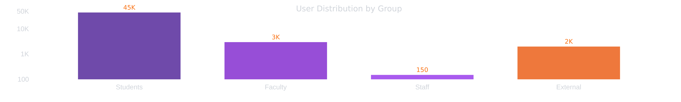







System Users Analysis
Four primary user groups with distinct profiles and needs
Students
Faculty
Library Staff
External Users
45,000 users
3,000 users
150 users
2,000 users
Age: 18-25 years
Age: 30-65 years
Age: 25-60 years
Alumni, community members
High technical proficiency
Medium to high technical skills
Medium technical proficiency
Visiting researchers
Daily usage during semester
Weekly usage
Daily usage (full shift)
Limited privileges
70% mobile app usage
60% web portal usage
Desktop app primary access
On-site access only
Key Needs:
Key Needs:
Key Needs:
Key Needs:
Quick search, reservations, e-books, study rooms
Extended loans (8 weeks), higher limits (20 books)
Fast check-in/out, override rules, inventory tools
Registration approval, shorter loans, on-site access
2/5

Slide 3

























Core System Functions
Nine key functional areas powering library operations
User Management
Catalogue Management
Circulation Functions
Registration & Authentication
Book Search & Discovery
Borrowing & Returning
SSO via university ID
Advanced search options
Check-out/in processes
Two-factor authentication
Browse by classification
Reservation system
User profile management
Staff catalogue administration
Overnight loans
Fine Management
Digital Library
Study Room Booking
Inter-Library Loan
Reporting & Analytics
Notification System
Fines & Payments
E-books & Journals
Automated Alerts
£0.50 per day overdue
Room Reservation
ILL Requests
System Monitoring
Due date reminders
50,000 e-book titles
Partner library access
Multiple channels
Payment methods
10,000+ academic journals
1-4 hour slots
User activity reports
Equipment filtering
Tracking system
Inventory status
3/5

Slide 4














System Constraints & Requirements
Key performance, security, usability, and legal constraints
Performance Constraints
Security Constraints
System performance and scalability requirements
Authentication, authorization and data protection
Uptime: 99.9% during academic year (Sep-May), 99% during summer
Authentication: RBAC with 5 levels, SSO, two-factor for staff
Password policy: Min 12 characters, complexity requirements
Response time: Search queries < 2s, check-out < 5s
Data protection: AES-256 encryption at rest, TLS 1.3 in transit
Throughput: Support 5,000 concurrent users, 500 transactions/minute
Audit & compliance: All actions logged, quarterly security audits
Scalability: Scale to 100,000 users without architecture redesign
Usability Constraints
Legal & Regulatory Constraints
Accessibility and user experience requirements
Compliance and legal requirements
Accessibility: WCAG 2.1 Level AA compliance, screen reader support
Copyright: Digital content served under publisher licenses
Data Protection: UK GDPR compliance, Data Protection Act 2018
UI/UX: Responsive design (320px-4K), consistent navigation
Accessibility: Equality Act 2010 compliance
Browser support: Chrome, Firefox, Safari, Edge (latest 2 versions)
Records Management: Retention schedules, secure disposal of data
Learnability: Basic tasks within 5 minutes without training
4/5

Slide 5





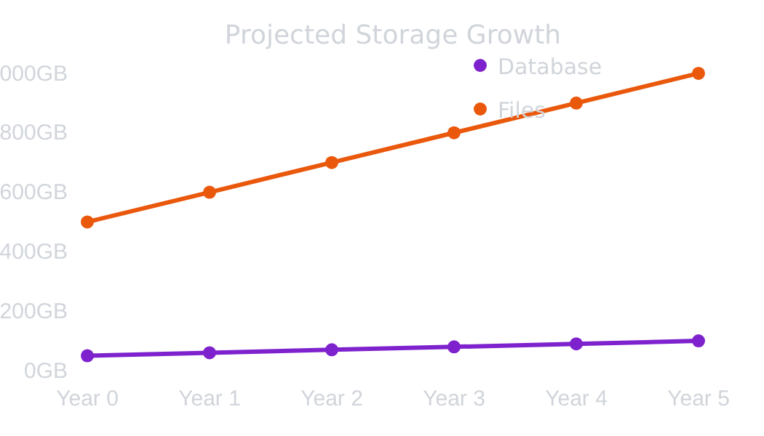






























Data Architecture & Requirements
Core database design with PostgreSQL implementation and comprehensive data management strategies
Core Data Entities
Storage Requirements
Backup & Migration
15 core database entities with 3NF normalization
Backup Strategy
USER
BOOK
BOOK_COPY
Hot backup (real-time replication)
Warm backup (daily full backup)
LOAN
RESERVATION
FINE
Cold backup (weekly to tape/cloud)
Recovery Time Objective: 4 hours
PAYMENT
LOCATION
EBOOK
Migration Strategy
EBOOK_LOAN
STUDY_ROOM
1. Export data from legacy system
2. Data cleaning and validation
ROOM_BOOKING
ILL
3. Transform to new schema
4. Load into staging database
NOTIFICATION
AUDIT_LOG
Database
File Storage
5. Validate data integrity
Initial: 50GB
Initial: 500GB
6. Cutover to production
Database Design:
Growth: 10GB/year
Growth: 100GB/year
3NF normalized with selective denormalization
5-year: 200GB
5-year: 1TB
GIN indexes for full-text search
Partitioned tables for performance
Network Requirements:
Bandwidth: 100 Mbps (min), 1 Gbps (recommended)
5/5

